Slide 1
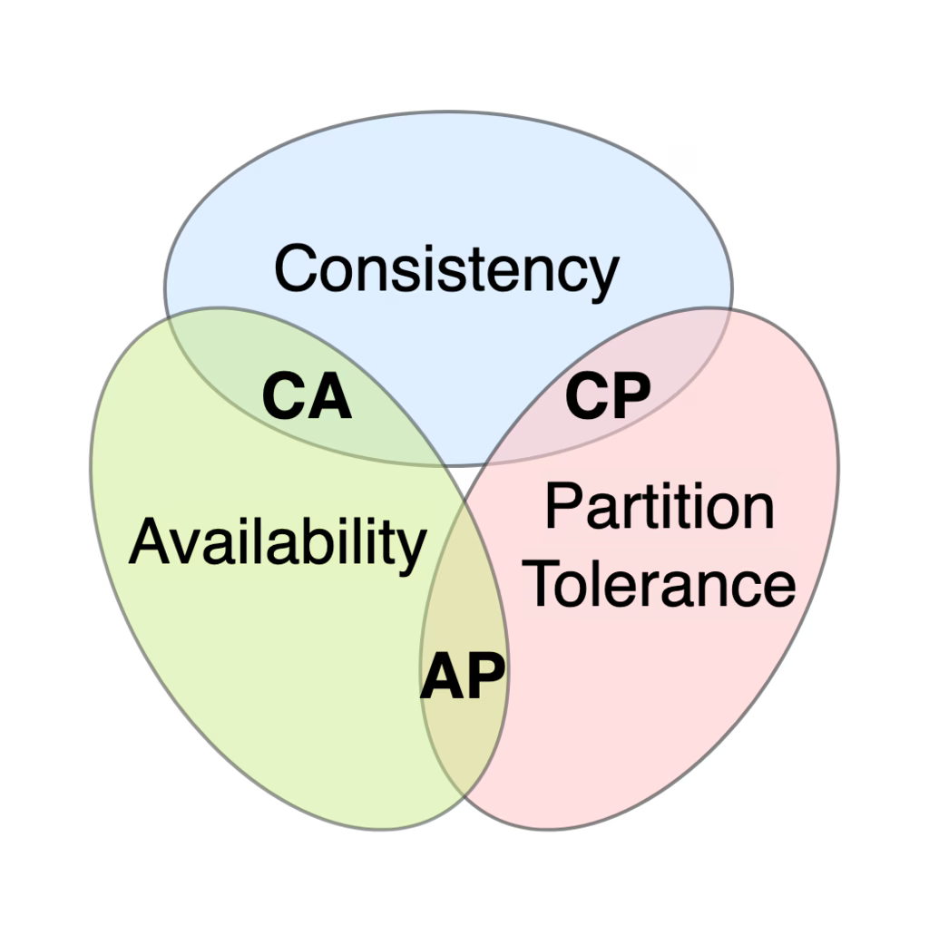
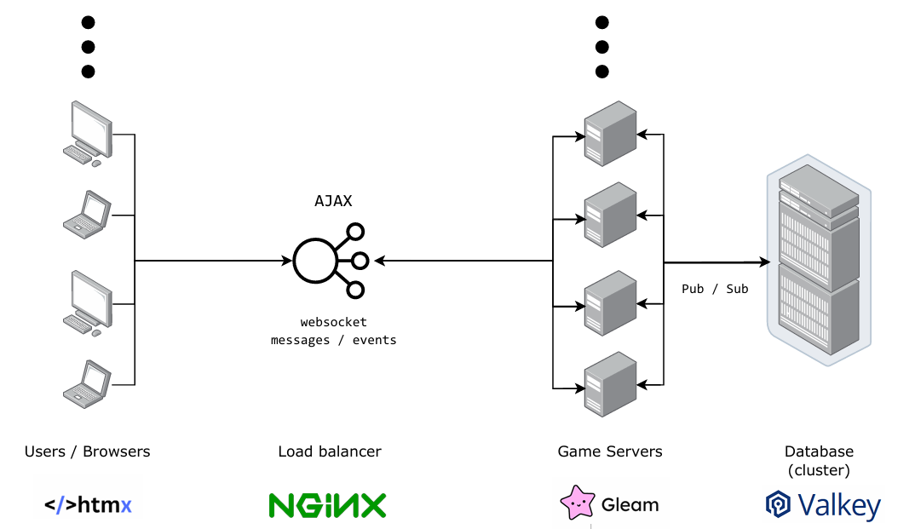
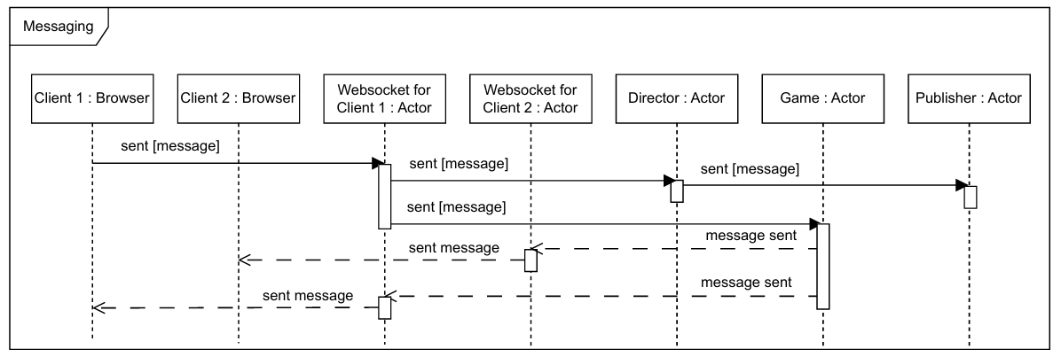


A Concurrency-Based Game Environment
Leveraging Gleam and the BEAM for Robust Multiplayer Game Systems
Multiplayer Games & Play; Entertainment, relaxation, …, critical thinking, social skills, emotional intelligence, building resilience, …
Concurrency Mechanisms; Simultaneous actions & game instances, race conditions, system reliability
real-time communication, real-time world updates, overiding actions, racing actions, compound actions
WebSockets • combination of SQL and NoSQL databases • Go, C++, C# (.NET) & Python
Steam; AP – business focus on modularity Epic Games Store; AP – business focus on integration Xbox Live; CA – business focus on live services
BG & Aims
A Survey Report on Game Environments
State-of-the-art Concurrency (Direct & indirect)
”Your parallel program only goes as fast as its slowest sequential part” - Amdahl’s law
Event Loops Single thread relying on non-blocking I/O operations
Coroutines Stackful (independent stack) & Stackless (state removal & context-based suspension)
Goroutines “don’t communicate by sharing memory, share memory by communicating.”
Web Workers Actor-style threads • High communication costs due to low bandwidth & lack of shared memory
Actors (Erlang) Encapsulate state and behavior within independent processes • Communicate solely through message passing
“Shared Nothing”, “Let it crash” & internal ”link” mechanism • OTP supervision trees
Research
Architectural paradigms, distribution, and design patterns
P2P vs client-server Authority, server failures, peer disconnections, data manipulation, upfront challenges; cost, latency, & scaling
Pool Architectures Dedicated instances & separate resource pools • Individual scaling & resource allocation • Centralized
Event driven architecture Communication through events representing state changes • Producers, routers, and consumers (entirely decoupled)
Microservices App structured as a collection of small, autonomous function-specific services
Saga Interaction Coordinating transactions w/ asynchronous messaging • Choreography & Orchestration
K8s Automating Linux containers • Steep learning curve & YAML sprawl • Can be self-regulating
Pub/Sub vs p2p Broadcasting vs direct channels • Scaling, coupling, throttling message consumption
TCP • UDP • Polling • Long Polling • WebRTC • WebSockets
(Example of interactions between my actors)
main_process
├── main_supervisor
│ └── director_actor
│ └── game_actor(s)
│ └── battle_child_supervisors(s)
│ └── battle_actors(s)
│ └── enemy_actors
└── web_server_supervisor
└── web_server_process
└── websocket_actor(s)
Programs
Online Chat (JS & Erl targets)
Tic-Tac-Toe (JS & Erl targets)
Pong ( Erl target )
Zarlasht ( Erl target )
By Faeq • Supervisor: Dr Julien Lange 2024-2025 CS3821 Final Year Project - Full Unit │ EPMS

